Slide 1
CSI Report, 1st year.
Development of a Finite Volume scheme on an adaptively refined Cartesian grid in the presence of
air/water interfaces.
Tommaso Zanelli
17/06/2020

Slide 2
Grid-flow solver
Formerly WCCH (Weakly-compressible cartesian hydrodynamics)
Developed by Nextflow Software and LHEEA of École Centrale de Nantes
High order finite volume discretization
Adaptively refined multi-level Cartesian grid
Immersed boundary method
Written in Fortran 90
MPI (Message Passing Interface) for parallelization

Slide 3
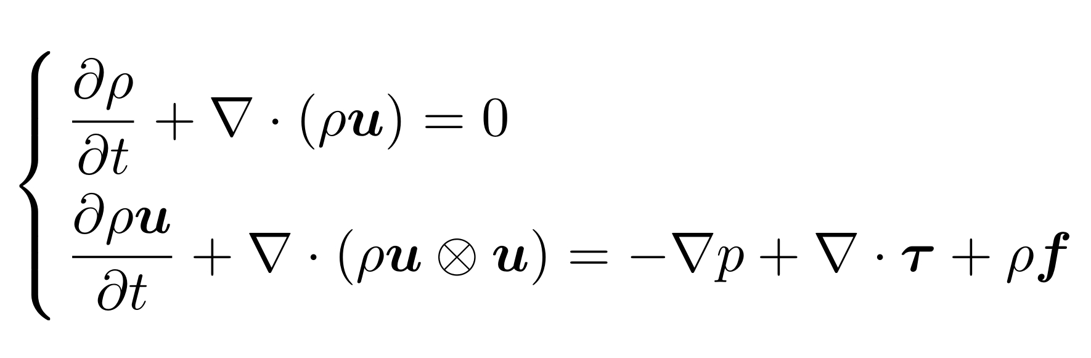
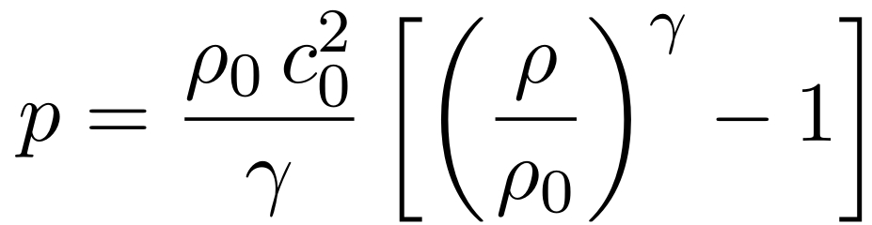
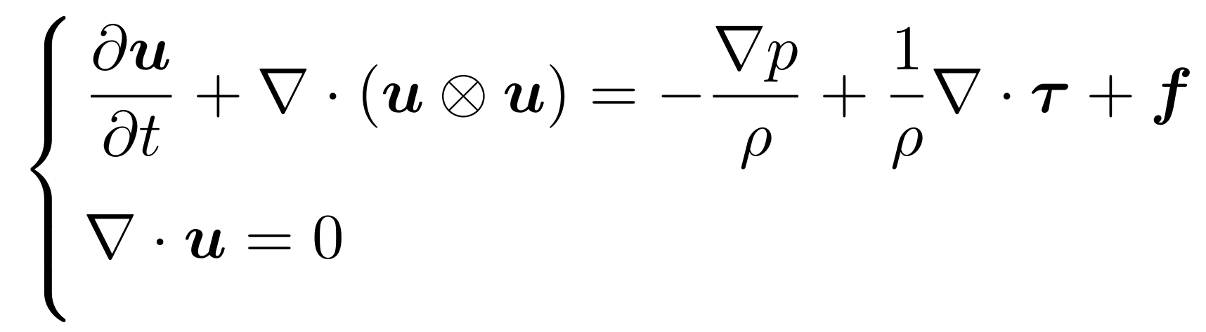
Grid-flow solver
Weakly-compressible formulation:
Incompressible formulation:

Slide 4
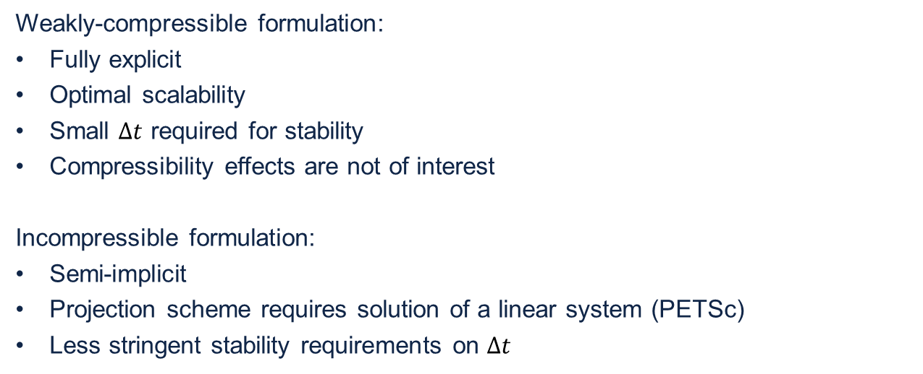
Grid-flow solver
Weakly-compressible formulation:
Fully explicit
Optimal scalability
Small $Δt$ required for stability
Compressibility effects are not of interest
Incompressible formulation:
Semi-implicit
Projection scheme requires solution of a linear system (PETSc)
Less stringent stability requirements on $Δt$

Slide 5
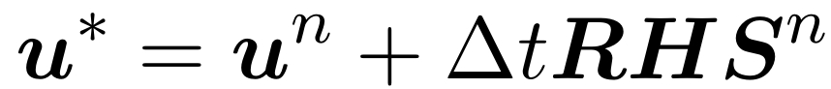
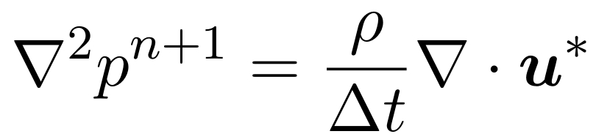
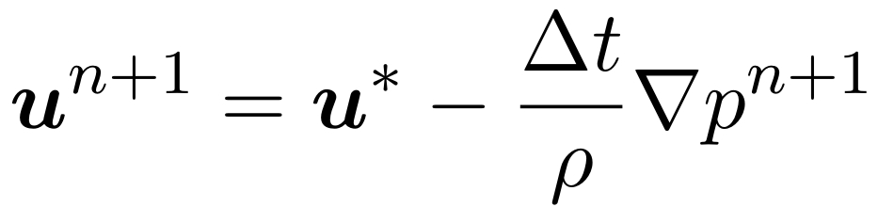
Grid-flow solver
Projection scheme
Chorin-Temam projection scheme (Classic^{[1][2]}):
Prediction step:
Pressure Poisson equation:
Velocity correction step:
[1]: Alexandre Joel Chorin. Numerical solution of the navier-stokes equations. Mathematics of computation, 22(104):745–762, 1968.
[2]: Roger Temam. Sur l’approximation de la solution des équations de navier-stokes par la méthode des pas fractionnaires (ii). Archive for rational mechanics and analysis, 33(5):377–385, 1969.

Slide 6
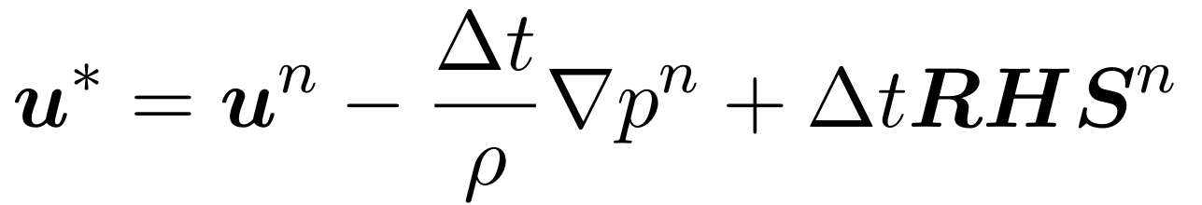
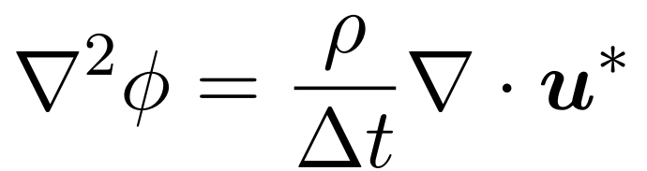
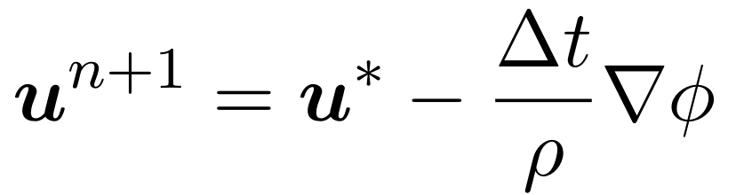
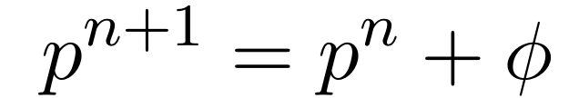
Grid-flow solver
Projection scheme
Chorin-Temam projection scheme (Incremental^{[3]}):
Prediction step:
Pressure correction Poisson equation:
Velocity correction step:
Pressure correction step:
[3]: Jean-Luc Guermond, Peter Minev, and Jie Shen. An overview of projection methods for incompressible flows. Computer methods in applied mechanics and engineering, 195(44-47):6011–6045, 2006.

Slide 7
Grid-flow solver
Staggered grid^{[4]}
[4]: Francis H Harlow and J Eddie Welch. Numerical calculation of time-dependent viscous incompressible flow of fluid with free surface. The physics of fluids, 8(12):2182–2189, 1965.

Slide 8
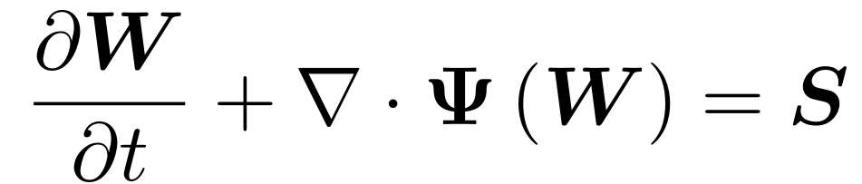
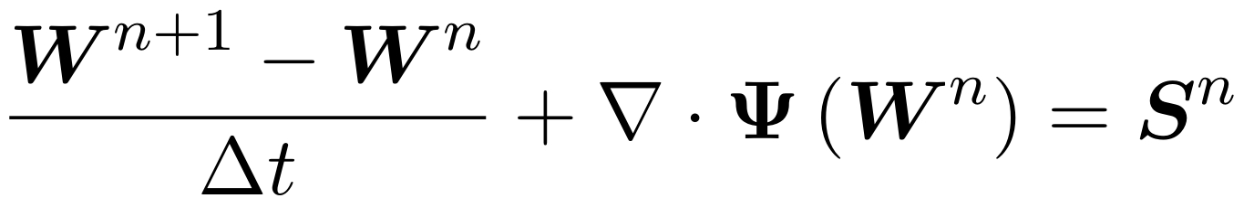
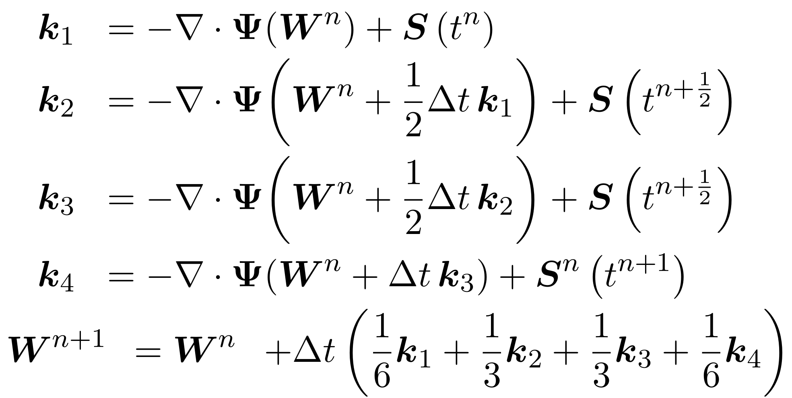
Grid-flow solver
Time integration
Set of Conservation Equations:
Time integration:
Forward Euler
Fourth-order Runge-Kutta

Slide 9
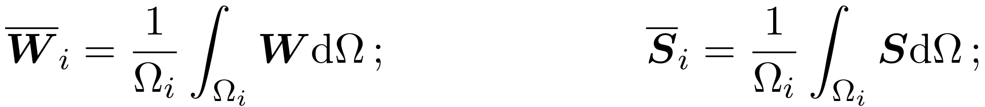
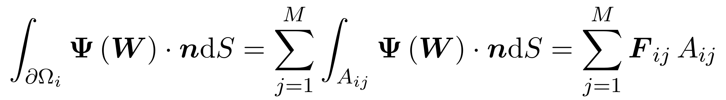
Grid-flow solver
Finite Volume formulation
Set of Conservation Equations:
Integration over control volume:
Volume averages:

Slide 10
Grid-flow solver
Finite Volume formulation
Set of Conservation Equations:
Control volume (3D) and fluxes:

Slide 11
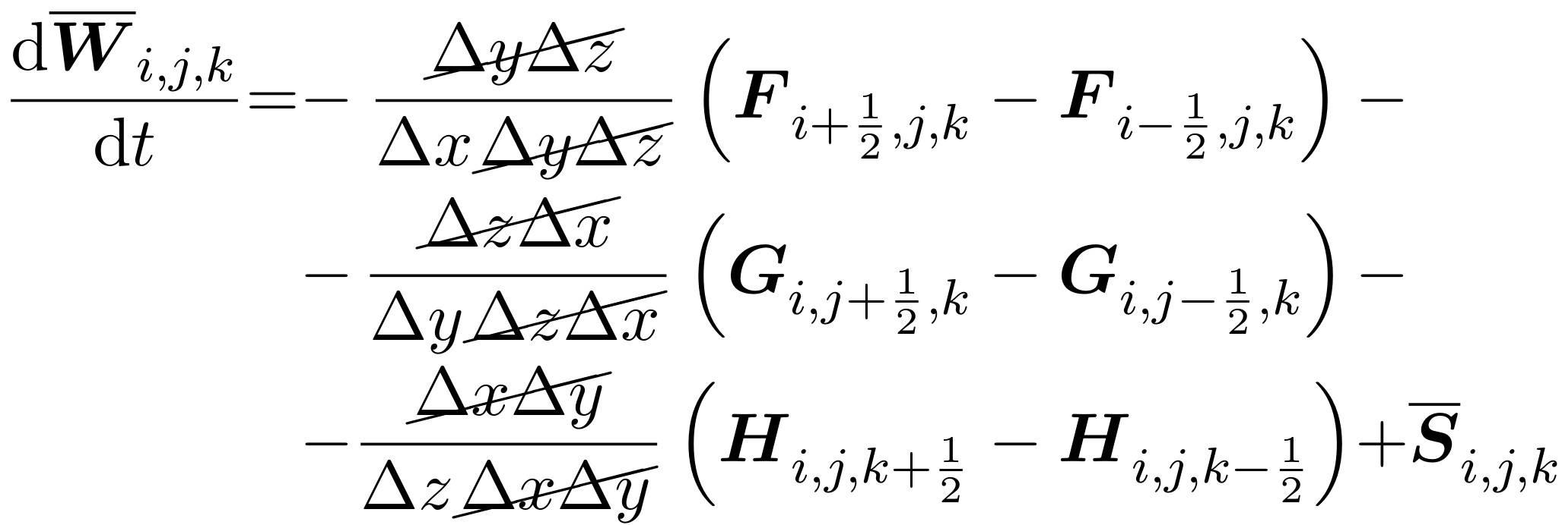
Grid-flow solver
Finite Volume formulation
Set of Conservation Equations:
Discrete formulation (3D Cartesian grid):

Slide 12
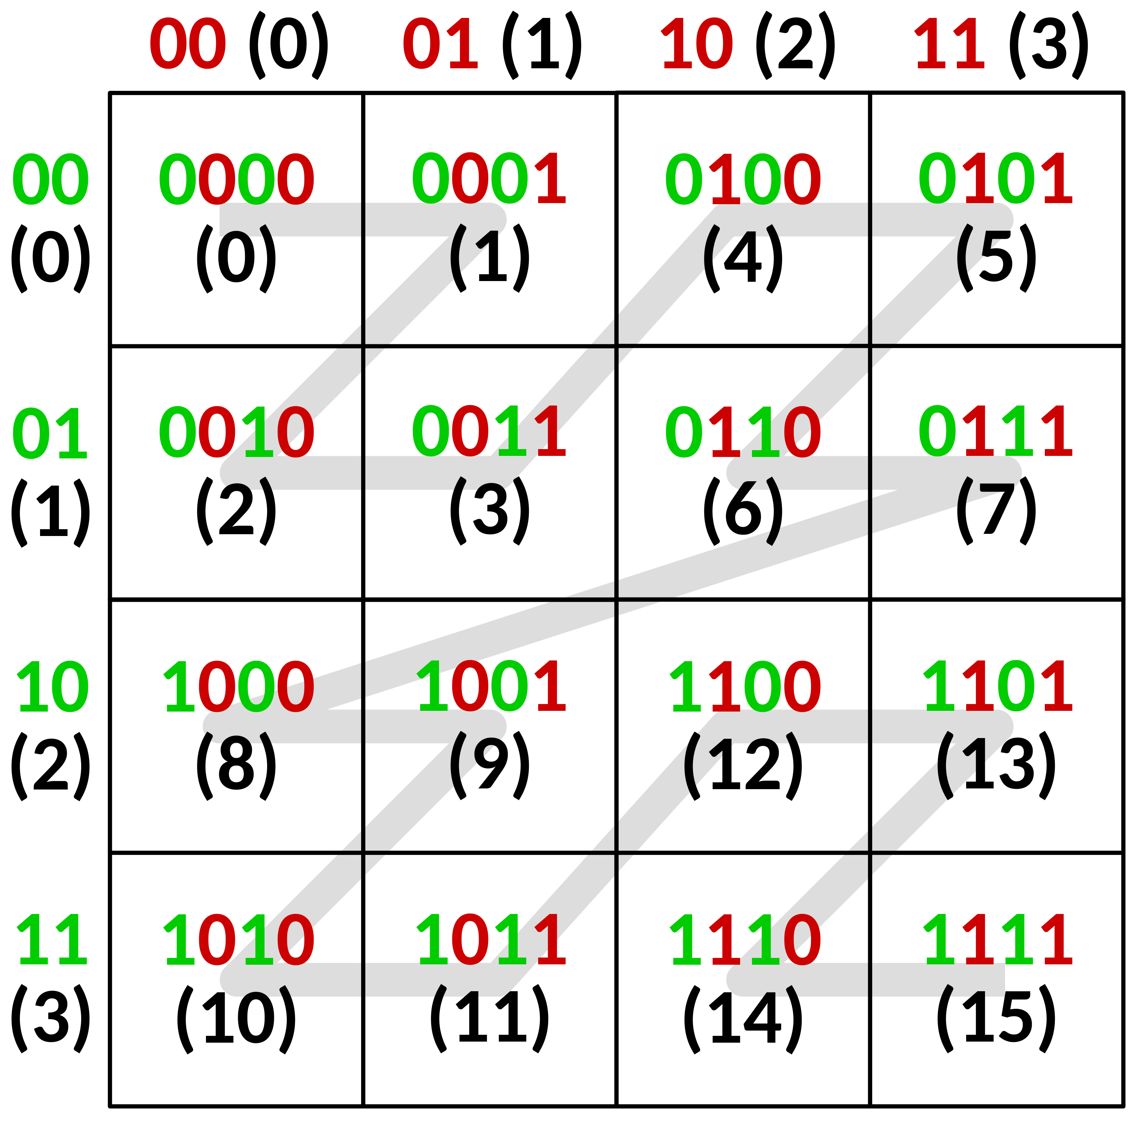
Grid-flow solver
Adaptive Mesh Refinement (AMR)
Z-Order curve:

Slide 13
Grid-flow solver
Adaptive Mesh Refinement (AMR)
Multi-level grid and quadtree:

Slide 14
Grid-flow solver
Adaptive Mesh Refinement (AMR)
Domain partitioned recursively into blocks, starting from a single one.
Each block can have four (2D) or eight (3D) children blocks.
Partitioning is continued until the desired level of refinement is reached.
Adjacent blocks must differ by at most one level of refinement.
Blocks are further divided into a fixed number of cells.

Slide 15
Grid-flow solver
Parallelization

Slide 16
Grid-flow solver
Adaptive Mesh Refinement (AMR)
An operation is performed on the inner blocks first.
The updated values at the inner blocks are sent to the neighbour processes.
The operation is performed on the local blocks
The updated inner block values from the neighbour processes are received and used to fill the outer blocks.

Slide 17
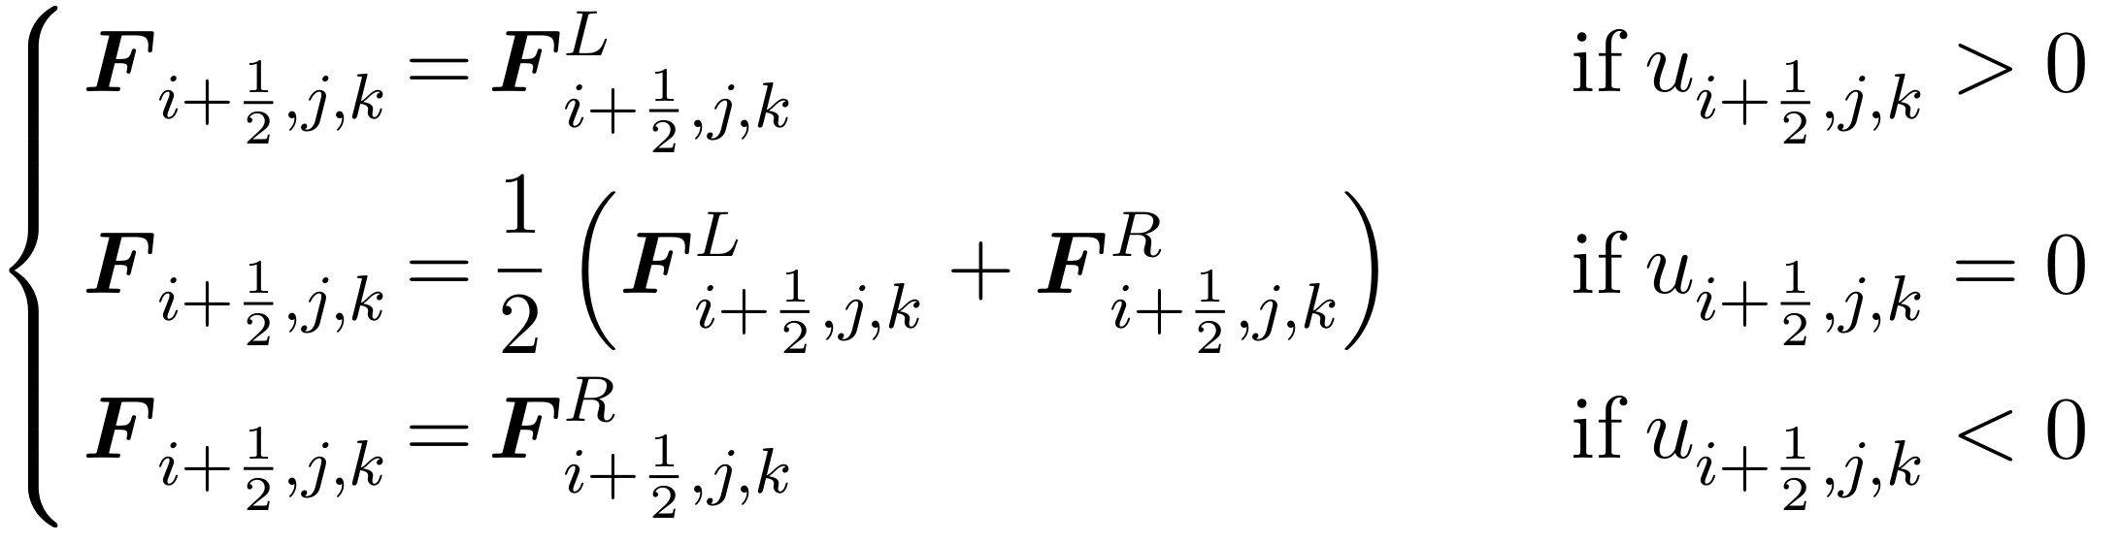
Grid-flow solver
Numerical fluxes
At each interface two reconstructions are performed:
In the incompressible formulation, the flux in each direction is chosen as

Slide 18
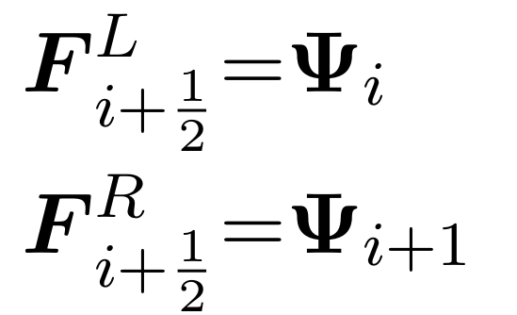
Grid-flow solver
Numerical fluxes – first order reconstruction
This consists in assigning the left and right fluxes as the values at the centre of the left and right cells respectively:

Slide 19
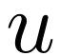
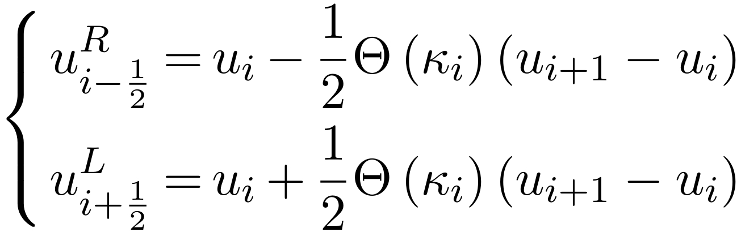
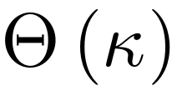
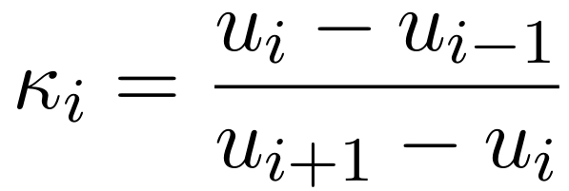
Grid-flow solver
Numerical fluxes – MUSCL^{[5]} reconstruction
A quantity is reconstructed as:
Where is called limiter and
One example is the Minmod limiter:
[5]: Pierre Bigay. Développement d’un solveur faiblement compressible sur maillage Cartésien
pour les écoulements hydrodynamiques autour de corps. PhD thesis, 2015.

Slide 20
Grid-flow solver
Numerical fluxes – WENO reconstruction^{[6]}
Three stencils are considered over five cells:
[6]: Louis Vittoz. Contributions au développement d’un solveur volumes finis sur grille cartésienne localement raffinée en vue d’application à l’hydrodynamique navale. PhD thesis, 2018.

Slide 21
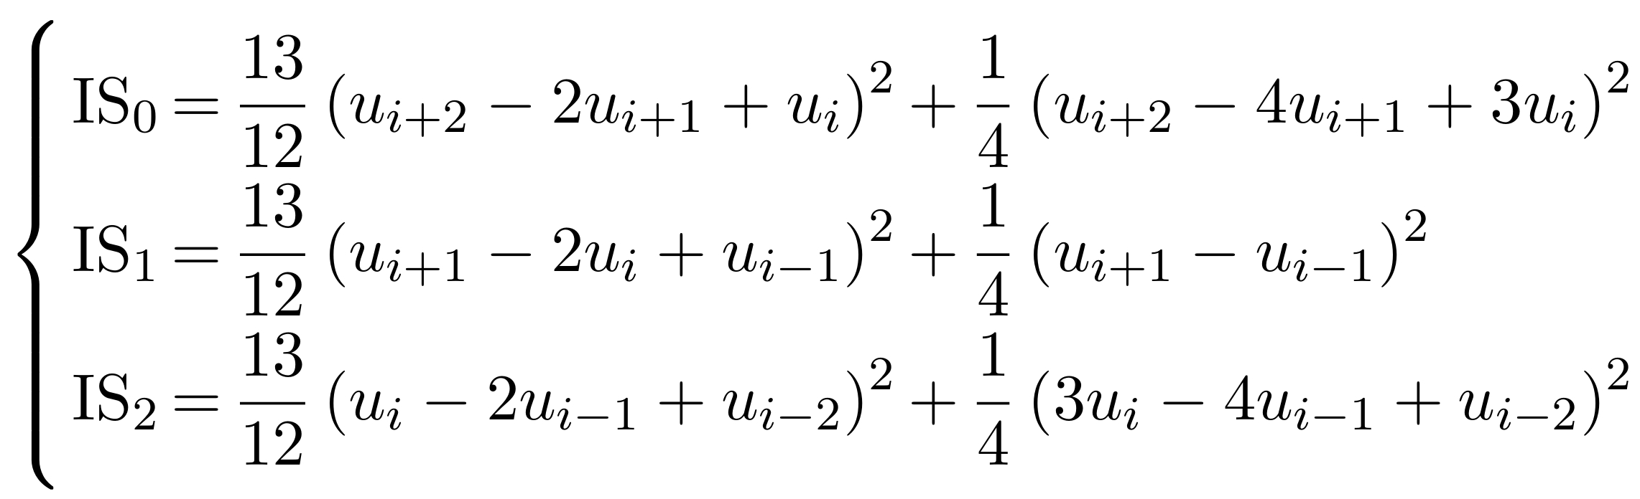
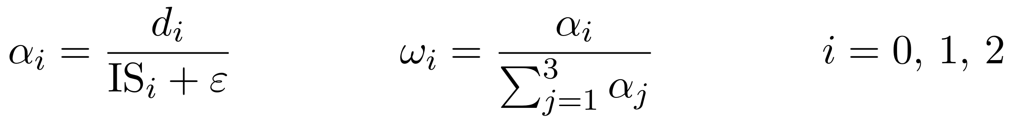
Grid-flow solver
Numerical fluxes – WENO reconstruction
Smoothness indicators are defined over the stencils:
And used to compute the weights:
With:

Slide 22
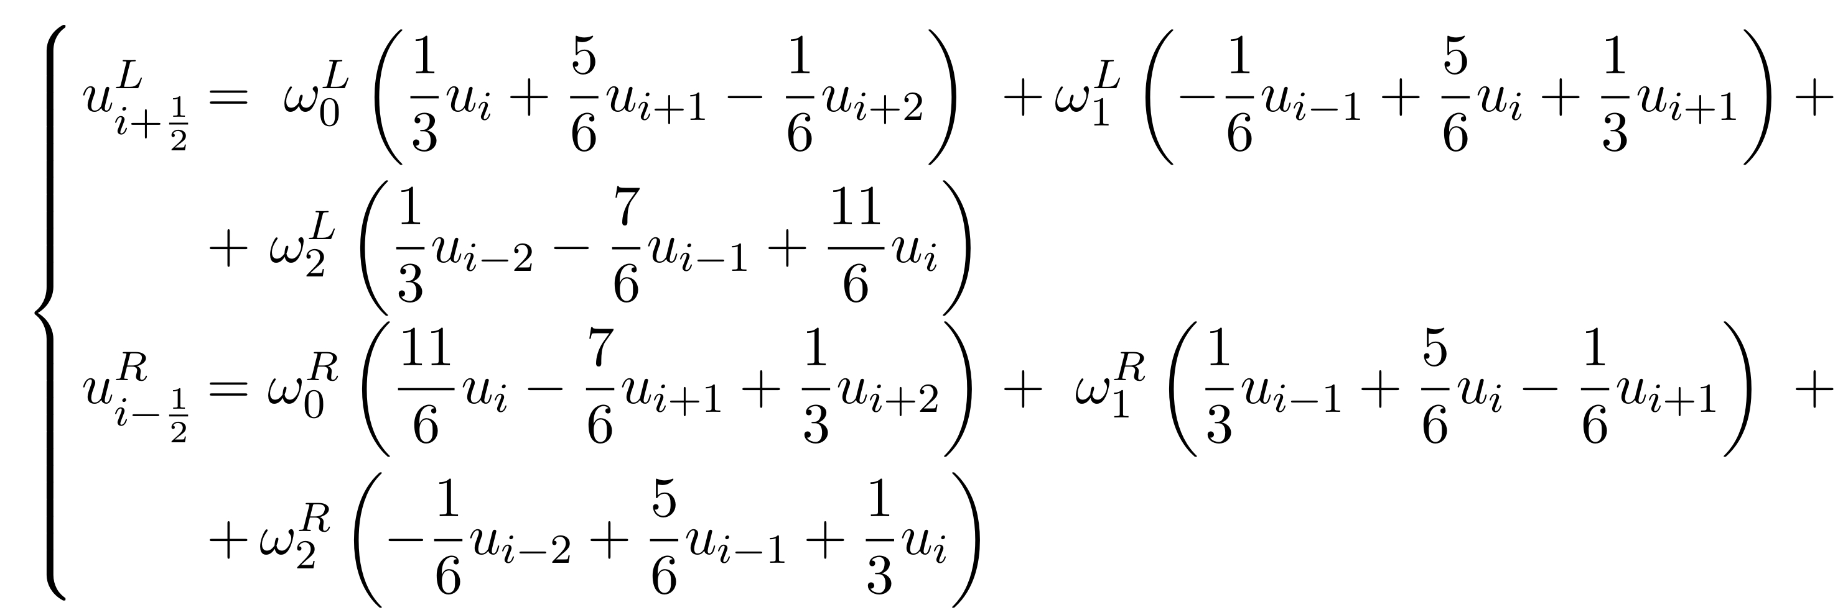
Grid-flow solver
Numerical fluxes – WENO reconstruction
The reconstructed values are:

Slide 23
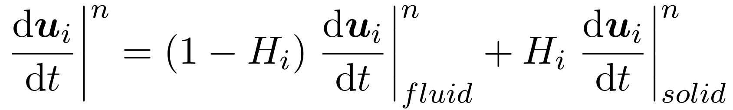
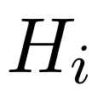
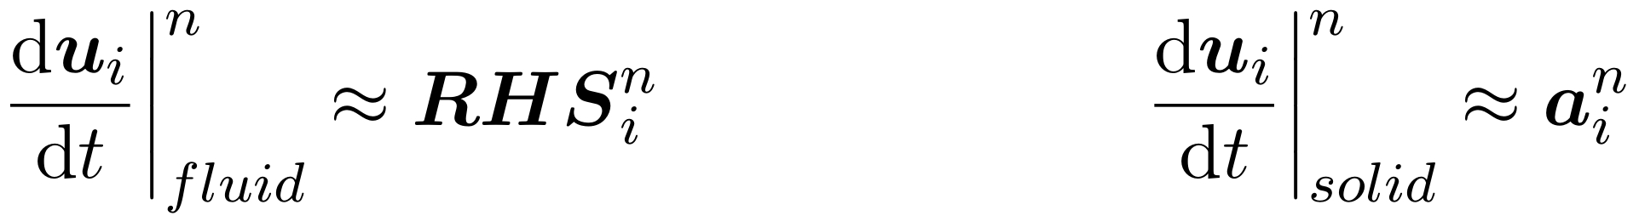
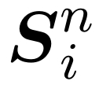
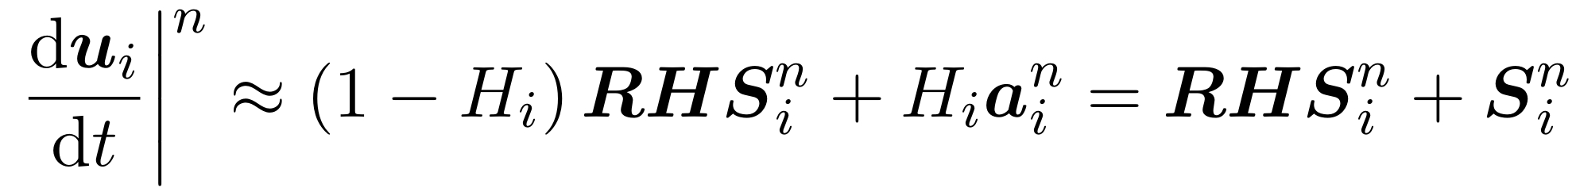
Grid-flow solver
Immersed Boundary^{[6]}
Momentum in a cell is given as the sum of a solid and a fluid contribution:
With the volume fraction occupied by the solid, and:
This allows for the definition of a source term , such that:
[6]: Louis Vittoz. Contributions au développement d’un solveur volumes finis sur grille cartésienne localement raffinée en vue d’application à l’hydrodynamique navale. PhD thesis, 2018.

Slide 24
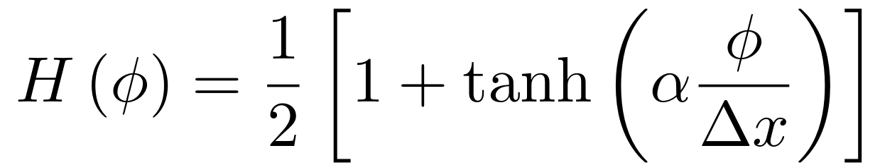
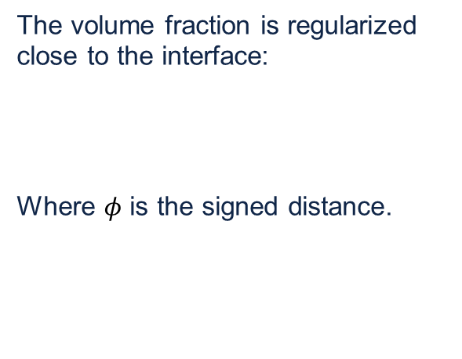
Grid-flow solver
Immersed Boundary
The volume fraction is regularized close to the interface:
Where $φ$ is the signed distance.

Slide 25
Multiphase Flows
Problem breakdown^{[7]}:
Numerical description for the location and shape of the boundary
Evolution algorithm for the boundary
Scheme for imposing boundary conditions at the interface
[7]: Cyril W Hirt and Billy D Nichols. Volume of fluid (vof) method for the dynamics of
free boundaries. Journal of computational physics, 39(1):201–225, 1981.

Slide 26
Multiphase Flows
1. Boundary numerical description
Lagrangian methods
Volume of Fluid
Level Set

Slide 27
Multiphase Flows
1. Boundary numerical description
Lagrangian methods:
A set of massless particles is introduced and advected with the fluid.
The particles are used to tag either:
One of the two fluids: Volume tracking (i.e. Marker and Cell^{[4]})
The interface itself: Surface tracking
[4]: Francis H Harlow and J Eddie Welch. Numerical calculation of time-dependent viscous incompressible flow of fluid with free surface. The physics of fluids, 8(12):2182–2189, 1965.

Slide 28
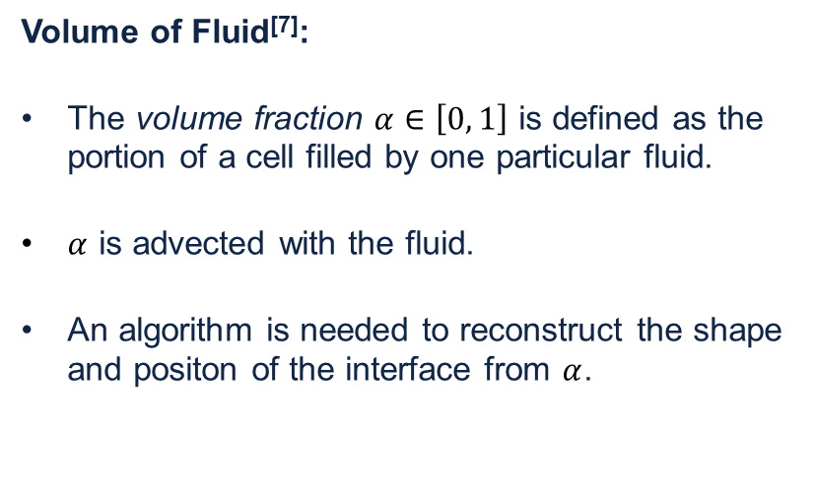
Multiphase Flows
1. Boundary numerical description
Volume of Fluid^{[7]}:
The volume fraction $α∈\left[0, 1\right]$ is defined as the portion of a cell filled by one particular fluid.
$α$ is advected with the fluid.
An algorithm is needed to reconstruct the shape and positon of the interface from $α$.
1.0
1.0
0.6
0.6
0.9
0.2
0.1
0.2
0.0
[7]: Cyril W Hirt and Billy D Nichols. Volume of fluid (vof) method for the dynamics of free boundaries. Journal of computational physics, 39(1):201–225, 1981.

Slide 29
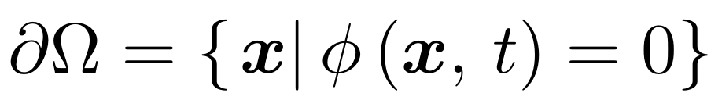
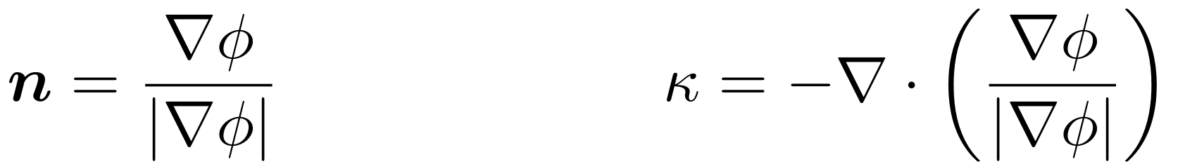
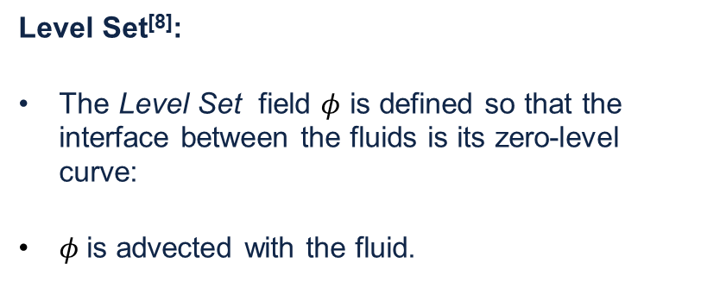
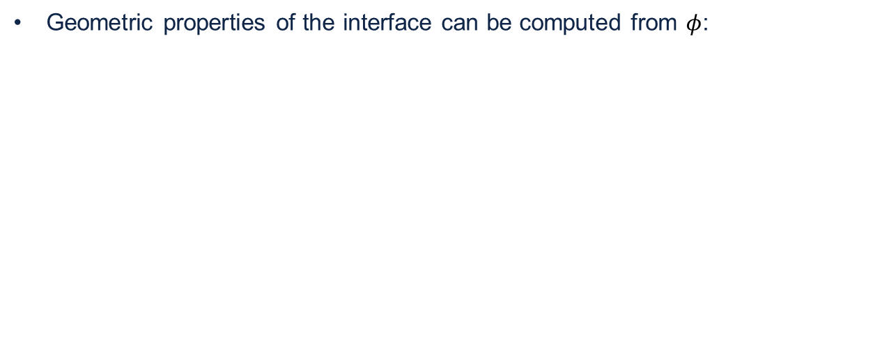

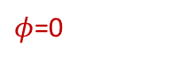
Multiphase Flows
1. Boundary numerical description
Level Set^{[8]}:
The Level Set field $φ$ is defined so that the interface between the fluids is its zero-level curve:
$φ$is advected with the fluid.
$φ$=0
$$n$$
Geometric properties of the interface can be computed from $φ$:
[8]: Stanley Osher and James A Sethian. Fronts propagating with curvature-dependent speed: algorithms based on hamilton-jacobi formulations. Journal of computational physics, 79(1):12–49, 1988.

Slide 30
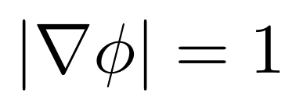
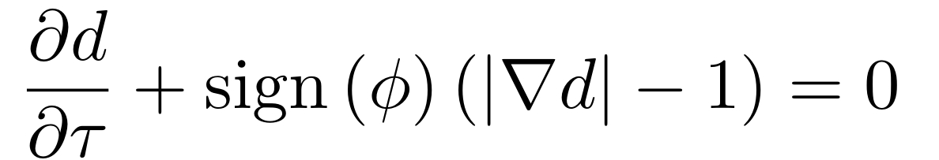
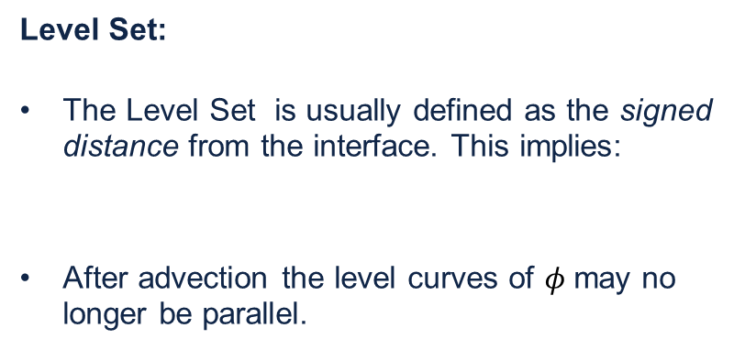
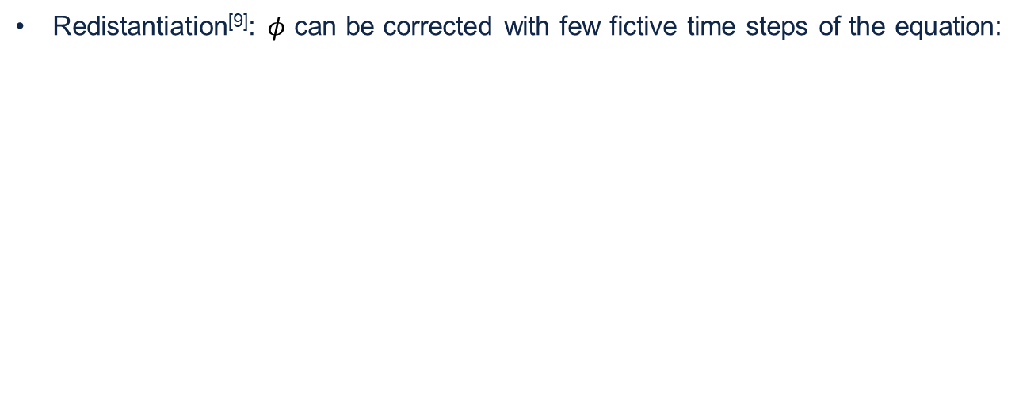
Multiphase Flows
1. Boundary numerical description
Level Set:
The Level Set is usually defined as the signed distance from the interface. This implies:
After advection the level curves of $φ$may no longer be parallel.
$φ$=0
$$n$$
Redistantiation^{[9]}: $φ$ can be corrected with few fictive time steps of the equation:
[9]: Daniel Hartmann, Matthias Meinke, and Wolfgang Schröder. Differential equation based constrained reinitialization for level set methods. Journal of Computational Physics, 227(14):6821–6845, 2008.

Slide 31
Multiphase Flows
1. Boundary numerical description
CLSVOF^{[10]} (Conservative Level Set – Volume of Fluid):
The Level Set offers a better description of the interface geometry than the Volume of Fluid, but has worst mass conservation properties.
The two approaches can be coupled by:
and used to correct each other.
[10]: Thibaut Ménard. Développement d’une méthode Level Set pour le suivi d’interface. Application de la rupture de jet liquide. 2007.

Slide 32
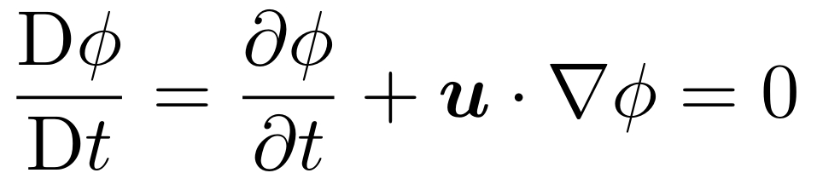
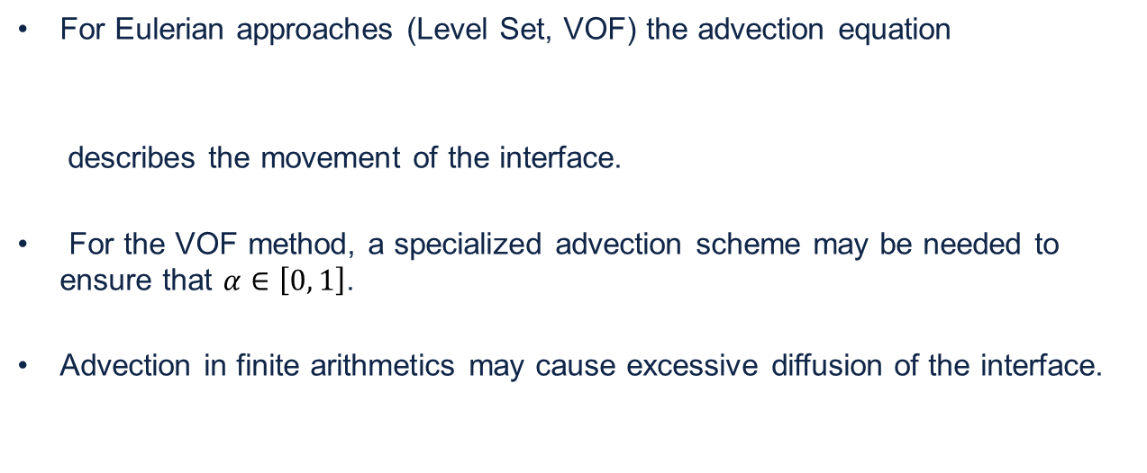
Multiphase Flows
2. Evolution algorithm for the boundary
For Eulerian approaches (Level Set, VOF) the advection equation
describes the movement of the interface.
For the VOF method, a specialized advection scheme may be needed to ensure that $α∈\left[0, 1\right]$.
Advection in finite arithmetics may cause excessive diffusion of the interface.

Slide 33
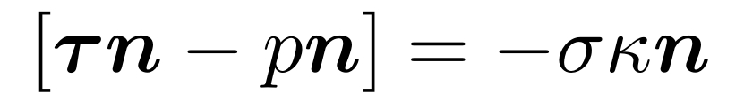
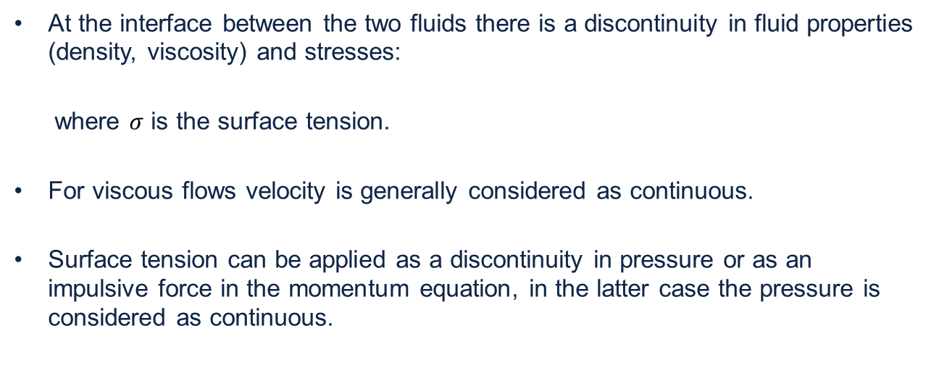
Multiphase Flows
3. Boundary conditions at the interface
At the interface between the two fluids there is a discontinuity in fluid properties (density, viscosity) and stresses:
where $σ$ is the surface tension.
For viscous flows velocity is generally considered as continuous.
Surface tension can be applied as a discontinuity in pressure or as an impulsive force in the momentum equation, in the latter case the pressure is considered as continuous.

Slide 34
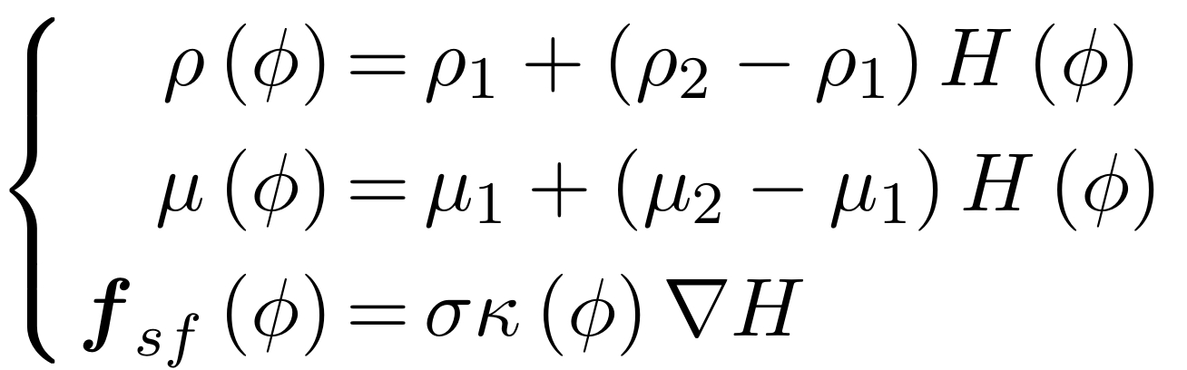
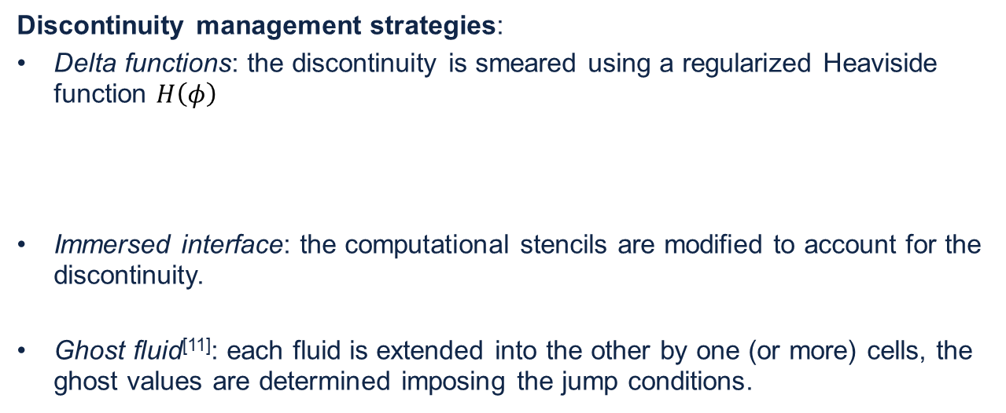
Multiphase Flows
3. Boundary conditions at the interface
Discontinuity management strategies:
Delta functions: the discontinuity is smeared using a regularized Heaviside function $H\left(φ\right)$
Immersed interface: the computational stencils are modified to account for the discontinuity.
Ghost fluid^{[11]}: each fluid is extended into the other by one (or more) cells, the ghost values are determined imposing the jump conditions.
[11]: Ronald P Fedkiw, Tariq Aslam, Barry Merriman, Stanley Osher, et al. A non-oscillatory Eulerian approach to interfaces in multimaterial flows (the ghost fluid method). Journal of computational physics, 152(2):457–492, 1999.

Slide 35
Implementation
Variable density
Incompressible
Level Set advection
Weakly-compressible
Level Set advection
Incompressible
Multiphase flow
Incompressible
Recovered by Guillaume Oger from the work of Amélie Bardin^{[12]}
New developments
[12]: Amélie Bardin. Développement de méthodes d’interface dans un solveur hydrodynamique basé sur une résolution volumes finis sur maillage cartésien en hypothèse faiblement compressible. PhD thesis, 2015.

Slide 36



Implementation
Method summary
Viscosity and surface tension are not considered.
The conservative form of the advection equation for $φ$ is used.
The method can be summarized in the following passages:
Update the Level Set:
Compute the intermediate velocity field:

Slide 37



Implementation
Method summary
Compute the density at the cell faces:
Solve the variable coefficient Poisson equation for the pressure:
Apply the pressure gradient to correct the vector field:

Slide 38
Implementation
Level Set Advection
In the incompressible formulation the Level Set is placed at the cell centres while the velocity is placed at the cell faces.
In the earlier version of the code (2019) on which this work started, no high-order reconstruction scheme was available to cell-centred variables in the incompressible formulation.
In earlier tests, a first order reconstruction had to be used for the Level Set.
The multipasic scheme was adapted to a more recent (2020) version of the code, removing this restriction.
Later tests employ the WENO and MUSCL reconstruction schemes for the Level Set.

Slide 39


Implementation
Variable coefficient Poisson Equation
Divergence matrices are constructed so that they perform centred finite differences on face-centred variables, i.e.:
The gradient matrices are obtained as their transpose:

Slide 40


Implementation
Variable coefficient Poisson Equation
In the monophasic case, the Laplacian and the right-hand side term of the Poisson equation for the pressure are computed as:

Slide 41


Implementation
Variable coefficient Poisson Equation
In the multiphase scheme, the Level Set is interpolated at the cell faces and used to compute the density. The diagonal matrices
Are built and used to obtain the Laplacian matrix and the right-hand side term of the Poisson equation:

Slide 42



Results
Level-Set avection – Zalesak disk^{[13]}
Domain: $\left[0, 1\right]×\left[0, 1\right]$
Velocity field: $\left\{\begin{aligned}u=−Ω\left(y−y_{0}\right) \\ v= Ω\left(x−x_{0}\right)\end{aligned}\right.$
With: $\begin{matrix}x_{0}=0.5 \\ y_{0}=0.5 \\ Ω=2π\end{matrix}$
Base grid: $64×64$ cells
Dynamic AMR
min. cell size: $3.90625∙{10}^{−2}$
$$φ<0$$
$$φ>0$$
[13]: Steven T. Zalesak. Fully Multidimensional Flux-Corrected Transport Algorithms for Fluids. Journal of computational physics, 31(3):335–362, 1979.

Slide 43
Results
Level-Set avection – Zalesak disk
Dynamic AMR:

Slide 44

Results
Level-Set avection – Zalesak disk
1st order accurate reconstruction (2019)
WENO reconstruction (2020)

Slide 45
Results
PETSc Reinitialization test
Variable density means the Laplacian matrix for the pressure Poisson equation needs to be reinitialized at every time iteration. This comes at a performance cost.
The Taylor-Green vortex test case was run with and without reinitializing the solver.
The test was run on two 12-core Intel Xeon E5-2680v3.

Slide 46

Results
PETSc Reinitialization test
Taylor-Green vortex test setup:

Slide 47
Results
PETSc Reinitialization test

Slide 48


Results
Poisson equation convergence test
The accuracy of the operators used to solve the pressure Poisson equations are tested by initializing the velocity field:
A singe time step is performed, having disabled advection and the source term. The pressure is compared with the analytical solution:

Slide 49

Results
Poisson equation convergence test
2019 code
2020 code
Number of cells per side
Number of cells per side

Slide 50






2020 Results
Hydrostatic test
A $\left[0, 1\right]×\left[0, 1\right]$ domain surrounded by solid walls is filled with two immiscible fluids with different densities, subjected to the force of gravity. Both fluids are initially still.
Ideally, the fluid should remain still. However, small errors in the solution of the pressure Poisson equation are amplified through the movement of the Level Set, causing growing oscillations.
$$ρ=1$$
$$1$$
$$0.5$$
$$ρ=1000$$
$$1$$

Slide 51
2020 Results
Hydrostatic test
Spurious oscillations ripple the interface between the two fluids, shedding vortices in the lighter one.

Slide 52
2020 Results
Hydrostatic test
Growth of the oscillations amplitude for a 32x32 grid

Slide 53
2020 Results
Hydrostatic test
The oscillations amplitude grows exponentially at the beginning, then stabilizes.
The simulation using WENO reconstruction crashes, however further tests ran smoothly.
These simulations use forward Euler for time integration, further tests with the fourth order Runge-Kutta scheme showed a lower asymptotical oscillation amplitude.

Slide 54

2020 Results
Linear sloshing
The same domain as in the hydrostatic test case was used, but with the addition of a horizontal acceleration equal to 0.5 m/s².
The interface does not start from an equilibrium position, hence it starts to oscillate.
A 256x256 grid was used, the simulation ran for 4 seconds.

Slide 55

2020 Results
Linear sloshing
An analytic expression for the vertical position of the interface can be derived from linearized potential theory^{[12][13]}:
[12]: Amélie Bardin. Développement de méthodes d’interface dans un solveur hydrodynamique basé sur une résolution volumes finis sur maillage cartésien en hypothèse faiblement compressible. PhD thesis, 2015.
[13]: N Grenier, J.-P. Vila, and P Villedieu. An accurate low-Mach scheme for a compressible two-fluid model applied to free-surface flows. Journal of Computational Physics, 252:119, 2013.

Slide 56
2020 Results
Linear sloshing

Slide 57







Results
Dambreak
$$ρ=1$$
A pocket of denser fluid is initially contained in a rectangle on the lower left of the domain, gravity ($g_{0}=−9.81$) acts vertically on both fluids.
$$0.5$$
$$0.25$$
$$ρ=1000$$
$$0.5$$
$$1$$

Slide 58

Results
Dambreak
2019 Test:
The velocity is advected using WENO, the Level Set using a first order accurate reconstruction
Dynamic AMR is used. The base grid is 128x64 cells, the finest cells have dimensions $Δx=1.953125⋅{10}^{−3}.$

Slide 59

Results
Dambreak
2019 Test:

Slide 60

Results
Dambreak
2019 Test:
The denser fluid disappears after 15 time units of simulation. This is likely due to the excessive diffusion of the Level-Set.
As seen on the right, the Level-Set becomes almost uniform by the end.

Slide 61

Results
Dambreak
The dambreak test was re-run with the 2019 code on a static 256x128 grid.
This revealed stability problems.
A careful choice of parameters, however, allows the 2019 code to run until completion.

Slide 62

Results
Dambreak
The same setup was run on the 2020 code, using WENO for both the velocity and the Level Set
Despite various attempts and variations, the use of WENO for both the velocity and the Level Set always causes divergence.

Slide 63
Results
Dambreak
Advection strategies tested on the 2020 code
Velocity reconstructed with WENO, Level-Set reconstructed with WENO.
Velocity reconstructed with WENO, Level-Set reconstructed with MUSCL.
Velocity reconstructed with MUSCL, Level-Set reconstructed with WENO.
Velocity reconstructed with MUSCL, Level-Set reconstructed with MUSCL.

Slide 64

Results
Dambreak

Slide 65
Results
Dambreak
 | WENO reconstruction for the velocity | MUSCL reconstruction for the velocity
WENO reconstruction for the Level-Set | Always unstable. Smoothness indicators can slow down instability. | Stable if smoothness indicators are active. Denser fluid does not disappear. Irregular density field.
MUSCL reconstruction for the Level-Set | Analogous to the 2019 code. Stable under certain conditions. Smoothness indicators play no role. Denser fluid disappears completely. | Stable and regular. Denser fluid does not disappear. Lower velocity.

